Slide 1

Easy, breezy, risky:
Lay investors fail to diversify because correlated assets feel more fluent and less risky
Yann Cornil | David J. Hardisty* | Yakov Bart
UBC Sauder | UBC Sauder | Northeastern University
* Presenting author
Presented at SJDM 2019 in Montreal
Notes:
Images from unsplash.com

Slide 2


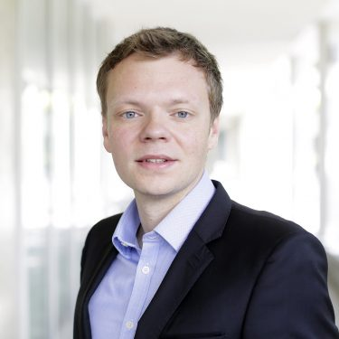

Co-authors
Yann Cornil
Yakov Bart

Slide 3
Do you prefer A and B? Or A and C?
Fund A
Fund B
Fund C

Slide 4

Diversification 101
Fund A
Fund B
Fund C
Risk Minimizing Portfolio

Slide 5

Diversification 101
Fund A
Fund B
Fund C
Risk-Maximizing
Portfolio

Slide 6
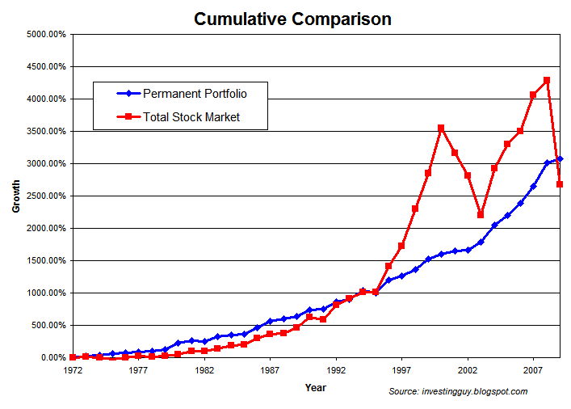
Why diversification is important
Financial diversification reduces portfolio risk (Markowitz 1952)
  People can limit their losses and reduce portfolio fluctuations without sacrificing much gain.
In most developed countries, workers allocate their savings (Lusardi 2009).
…and fail to diversify (Campbell 2006)
Diversifed
Non-Diversified

Slide 7
Example
 | 2015 | 2016 | 2017
TD U.S. Blue Chip Equity Fund | + 30.8% | - 4.7% | + 25.5%
TD Canadian Health Sciences Fund | + 32.8% | - 15.2% | + 17.3%
TD Canadian Small-Cap Fund | - 7.8% | + 18.7% | - 1.9%

Slide 8
Current Research
What we know:
Lay Investors ignore how covariance relates to risk (Hedesstrom et al. 2006 ; Benartzi & Thaler 2001)
They rely on subjective risk perception (Dowling and Staelin 1994; Slovic 1987; Slovic 1972)
Lay risk perception largely relies on perceived fluency (what’s disfluent is risky) (Alter & Oppenheimer, 2009a; Alter et al., 2007)
What we don’t know:
How covariance information (past or expected performances) impacts subjective risk perception and investment decisions
What we propose:
Lay investors judge risk based on how fluently they process covariance information Negative Correlation ➔ Disfluency ➔ Perceived Risk
Lay investors avoid negatively correlated assets, erroneously thinking that they increase risk

Slide 9
Overview of Studies
All run on MTurk
Study 1 (n=900), exploring reasons
Study 2 (n=395), mediation by fluency & risk
Study 3 (n=615), manipulating risk preference
Study 4 (n=603), debiasing intervention 1
Study 5 (n=408), debiasing intervention 2

Slide 10
Study 1
Do “lay” investors actively avoid diversification?
How do “lay” vs “expert” investors think about risk?

Slide 11
Study 1: Methods
Please imagine that you have invested some of your savings in one mutual fund. You are considering investing in a second fund…
Fund Omega has tended to perform very similarly to the fund you already have: yielding positive returns when your fund also yielded positive returns, and yielding negative returns when your fund also yielded negative returns
Fund Epsilon has tended to perform quite differently from the fund you already have: yielding positive returns when your fund yielded negative returns, and yielding negative returns when your fund yielded positive returns
Which fund would you invest in?

Slide 12
Study 1 Methods
“Please try to explain your choice in a few sentences.”
(minimum 200 character response)
Answers were coded by two research assistants

Slide 13
Study 1: Financial Literacy Scale
19 objective knowledge items (none about diversification), drawn from previous literature (Fernandes, Lynch, & Netemeyer, 2014; Lusardi & Mitchell, 2011; Mandell, 2008; Volpe, Kotel, & Chen, 2002)
Sample items:
Do you think that the following statement is true or false? “Bonds are normally riskier than stocks.”
  True
  False
  I don't know
Consider the following companies and their betas. Which stock will underperform the others when the stock market rises by 10%:
  Blue Company Beta = 0.85
  Orange Company Beta = 1.05
  Purple Company Beta = -1.10
  Gold Company Beta = -0.95
  I don't know

Slide 14
Study 1: Lay investors avoid diversification

Slide 15
Study 1: Self-reported Reasons
Among those investing in the non-diversifying fund, three themes emerged:
  Simplicity (“It would be easier to track its performance and use the same strategies I use with my current fund. I like the idea of a fund similar to my own.”)
  Familiarity (“Because it works the same as my current account. I'm familiar with it and feel safe to have another one just like the current one.”)
  Predictability (“It makes me feel comfortable and more at ease knowing what to expect with my investments. It gives me peace of mind because I can plan and expect my returns to be a certain amount.”)

Slide 16
Study 1: Self-reported Reasons
Among those investing in the non-diversifying fund, some also mentioned:
  high profit (“I chose it because it they are both doing well I can sell them at the same time cash out and make money.”)
Among those investing in the diversifying fund, the majority mentioned:
  reduced volatility (“I would not have low points and high points. It would be steady income. One fund would offset the other fund. Like if I had two jobs that pay bi-weekly I would want my checks on opposite weeks.”)

Slide 17
Study 1: Summary
Low-financial literacy investors:
preferred a non-diversifying fund
mentioned simplicity, familiarity, and predictability as reasons

Slide 18
Study 1: Limitations
Verbal description of funds low in external validity, & may introduce confounds
Sequential choice means diversification is confounded with endowment
Process measure (self-reported explanation & coding) kind of wishy washy
All addressed in Study 2, of course!

Slide 19
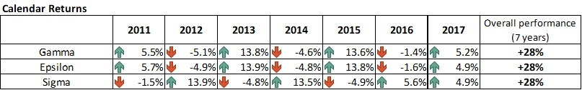
Study 2: Methods
Which portfolio would you prefer to invest in?
-2= Definitely Gamma & Epsilon to +2=Definitely Gamma & Sigma
Between-subjects: Sequential fund choice vs simultaneous fund choice (no difference)

Slide 20
Mediators (in random order)
Risk Perception:
  “Which portfolio seems riskier?”
  “Which portfolio seems safer?”
  “Which portfolio seems more dangerous?”
Volatility
  “Which portfolio is likely to fluctuate more over time (meaning sharply moving up and down)?”
Fluency: (9 items, α = .89)
  Familiarity: “Which portfolio would it be easier to get familiar with?”
  Predictability: “Which portfolio would have more predictable future performances?”
  Simplicity: “Which portfolio would be more confusing?” (R)

Slide 21
Non-diversified portfolio
(Gamma-Epsilon)
Diversified portfolio
(Gamma-Sigma)
Financial Literacy:
Top quartile (N=95)
2nd quartile (N=96)
3rd quartile (N=101)
Bottom quartile (N=91)
Top quartile
2nd quartile
3rd quartile
Bottom quartile
Top quartile
2nd quartile
3rd quartile
Bottom quartile
Top quartile
2nd quartile
3rd quartile
Bottom quartile

Slide 22
Study 2
Financial literacy
Fluency (simplicity, familiarity, predictability)
Diversification (investment in uncorrelated vs. correlated assets)
Risk perception
Volatility

Slide 23
Study 3: Manipulating risk preference
Instruct participants to maximize (vs minimize) risk
Should have opposite effects for high vs low financial literacy participants
Risk-avoiding instruction: “…make a low-risk investment. You don't care about trying to make huge returns, you only care about making a safe, low-risk investment.”
Risk-taking instruction: “…make an investment with high returns. You don't care if your investment is risky or unsafe, you only care about making a high-return investment.”

Slide 24
Study 3
Financial Literacy:
Top quartile (N=132)
2nd quartile (N=177)
3rd quartile (N=159)
Bottom quartile (N=128)
Non-diversified portfolio
(Gamma-Epsilon)
Diversified portfolio
(Gamma-Sigma)

Slide 25
Study 4: Debiasing
How can we debias people?
Previous research has found aggregating investment returns over time ("broad bracketing", Read, Loewenstein, & Rabin, 1999)
Analogously, if we aggregate across funds, this may debias low-financial literacy participants
  Aggregated returns should make the diversified portfolio more simple, predictable, and familiar

Slide 26
Study 4
control condition
“portfolio returns” condition

Slide 27
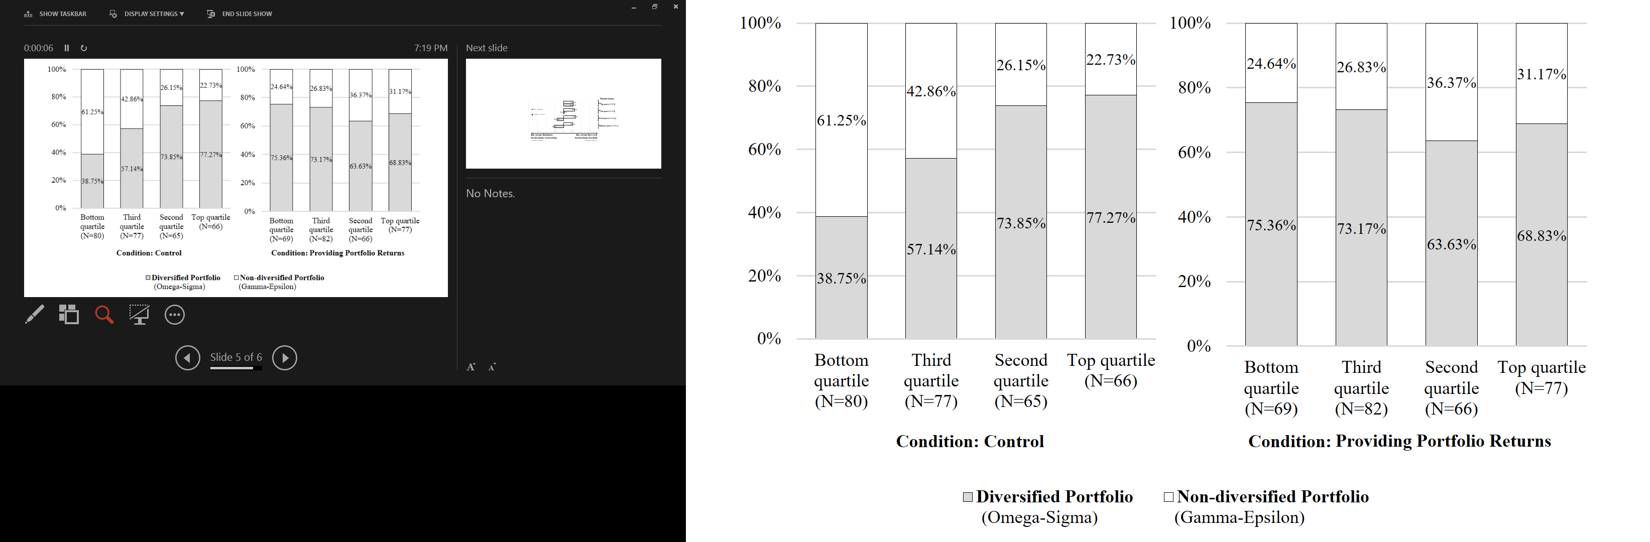

Slide 28
Study 5: Debiasing
Expected returns, rather than past returns
If we make the scenario more intuitive, will this debias participants?
“Abstract” vs “Concrete” scenario, within subjects
Inspired by Cosmides & Tooby (1992)
“If a person has a 'D' rating, then his documents must be marked code ‘3’”
“If a person is drinking beer, then he must be over 20 years old”

Slide 29
Study 5: Methods
“Concrete” condition
“Imagine that you want to invest in two of the following three videogame company stocks: Omega Games, Gamma Games, and Epsilon Games. All companies are profitable, but the expected returns of the stocks depend on the future success of videogame consoles.
Omega and Gamma both have an exclusivity deal with the videogame console "GameStation", while Epsilon has an exclusivity deal with the videogame console "GameBox". Usually, only one videogame console is successful and wins the market…”

Slide 30
Study 5
Financial Literacy:
Top quartile (N=78)
2nd quartile (N=76)
3rd quartile (N=125)
Bottom quartile (N=111)
Risk Attitude: Risk-Seeking
Portfolio Choice: Non-diversified
(Omega-Gamma)
Risk Attitude: Risk-Averse
Portfolio Choice: Diversified
(Omega-Epsilon)

Slide 31
Study 5: Summary
Providing a concrete scenario to make the diversification more intuitive did NOT debias
Maybe not familiar enough?

Slide 32
Limitations
We always held profitability constant
In pilot testing: Line graphs of fund returns yielded inconsistent results – a lot of “stock picking” behavior

Slide 33
Summary of Contributions
“Lay investors” actively prefer correlated assets
For them, correlated assets feel more familiar, predictable, and simple, therefore less risky
Showing aggregate portfolio returns debiases them

Slide 34
Thank You!

Slide 35
Extra slides

Slide 36
Study 1
 |  |  | Financial literacy:
 |  |  | Bottom quartile | Third quartile | Second quartile | Top quartile
Reasons for choosing the non-diversifying fund (positive correlation with endowed fund)
Total number of participants |  |  | 145 | 117 | 64 | 70
Low risk |  | Participants explicitly reporting that it would be less risky, safer, more stable, less stressful, more trustworthy; they would feel more confident, it would feel "less like a gamble". | 61 | 53 | 24 | 22
Control |  | Participants reporting that it would be easier to track, monitor, or manage; it would be less confusing and more controllable. | 16 | 12 | 12 | 4
Predictability |  | Participants reporting that returns would be more predictable, more consistent, more expectable and less surprising; it would be easier to plan for the future. | 58 | 55 | 32 | 21
Familiarity |  | Participants reporting that assets would become more familiar, it would be easier to gain knowledge and understand how they work. | 27 | 28 | 12 | 8
Total "Lay" risk perception |  | Participants explicitly reporting low risk and/or control and/or predictability and/or familiarty | 97 | 85 | 47 | 38
High profit |  | Participants reporting that It would be more profitable (they could make a "double win"), especially if timing the market; making the other choice would cancel out profit. | 18 | 21 | 16 | 28
Indifference |  | Participants reporting that they answered randomly because they are indifferent. | 2 | 1 | 1 | 0
Other/No reason |  | Participants providing no clear reason, or merely paraphrasing the scenario, or making additional assumptions that were not included in the scenario. | 26 | 18 | 2 | 8
Reasons for choosing the diversifying fund (negative correlation with endowed fund)
Total number of participants |  |  | 85 | 112 | 105 | 115
"Expert" risk perception |  | Participants providing the "correct" reason to invest in uncorrelated assets (reduction of portfolio volatility), or at least having a close intuition of it. | 56 | 87 | 92 | 111
Variety-seeking |  | Participants just wanting something different, for the sake of variety. | 3 | 8 | 1 | 2
High risk |  | Participants reporting that the uncorrelated asset would be risky (corresponding to the "lay" risk perception), and that they are willing to take this risk. | 3 | 2 | 1 | 0
Indifference |  | Participants reporting that they answered randomly because they are indifferent. | 3 | 3 | 0 | 0
Other/No reason |  | Participants providing no clear reason, or merely paraphrasing the scenario, or making additional assumptions that were not included in the scenario. | 21 | 13 | 12 | 2

Slide 37
Study 2
Financial literacy
Fluency (simplicity, familiarity, predictability)
Diversification (investment in uncorrelated vs. correlated assets)
Risk perception
Volatility
 | Structural Equation Model (Volatility & Fluency → Risk →Investment)
 | Volatility → Risk → Investment |  |  | Fluency → Risk → Investment
Financial literacy | Total Effect | Indirect Effect | Residual Direct Effect | Total Effect | Indirect Effect | Residual Direct Effect
Top quartile (N=95) | β=-.25 [-.47,-.04]* | β=-.18 [-.29,-.08]* | β=-.07 [-.27,.13] | β=.33 [-.03,.68] | β=.13 [-.05,.30] | β=.20 [-.12,52]
2nd quartile (N=96) | β=-.10 [-.37,.16] | β=-.11 [-.23,.01]† | β=.00 [-.25,.26] | β=.06 [-.29,.41] | β=.20 [-.01,.42] † | β=-.15 [-.48,.19]
3rd quartile (N=101) | β=.00 [-.22,.23] | β=-.03 [-.14,.08] | β=.03 [-.18,.24] | β=.47 [.17,.77]* | β=.30 [.14,.47]* | β=.16 [-.11,.43]
Bottom quartile (N=91) | β=.12 [-.15,.39] | β=-.07 [-.17,.03] | β=.19 [-.10,.48] | β=.57 [.29,.85]* | β=.39 [.11,.66]* | β=.18 [-.21,.58]
Note. Coefficients and 95% confidence intervals. Confidence intervals obtained with bootstrapping (5,000 reps) for all total effects, indirect effects, and residuals direct effects.
* indicates significant effects (based on 95% confidence intervals).
† indicates marginally significant effects (based on 90% confidence intervals)

